Slide 1
모두의 딥러닝 #9-10
김은영

Slide 2
지금까지 배웠던 내용

Slide 3
What is machine learning?
• Limitations of explicit programming
- Spam filter: many rules
- Automatic driving: too many rules
• Arthur Samuel (1959)
▸ 스스로 프로그래밍이 가능한가???
기계학습(Machine Learning)이란 컴퓨터에게 명시적으로 프로그램을 하지 않고도 컴퓨터가 학습을 할 수 있는 능력을 갖도록 만드는 것

Slide 4

Supervised/Unsupervised learning
Unsupervised learning: un-labeled data
- Google news grouping
- Word clustering
• Supervised learning
; Learning with labeled examples (training set)

Slide 5
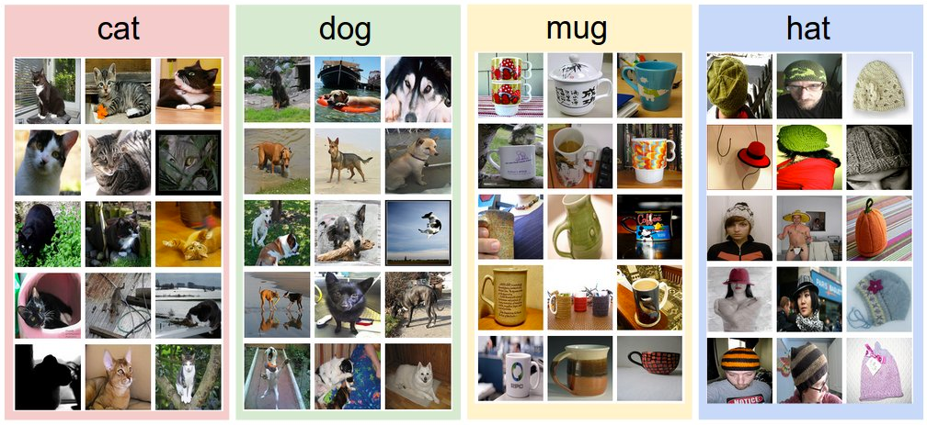
Supervised learning
An example training set for four visual categories.
Notes:
잘 알려진 예로, 고양이와 개, 머그잔과 모자등으로 레이블링된 사진data를 이용해서 학습한 후, 새로운 데이터를 입력하여 결과값을 도출하게 하는 경우입니다.

Slide 6
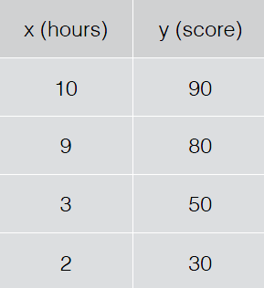
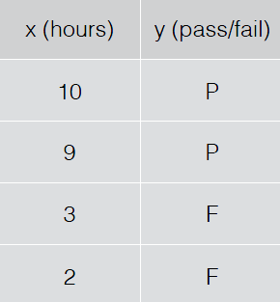
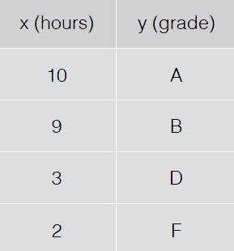
Types of supervised learning
• Predicting final exam score based on time spent
- Regression
• Pass/non-pass based on time spent
- Binary classification
• Letter grade (A, B, C, E and F) based on time spent
- Multi-label classification
Notes:
데이터와 label의 형태에 따라 여러가지 타입으로 분류할수 있습니다.
만약, 공부에 할애한 시간에 따른 시험점수 데이터를 통해서는 리그래션을, 공부시간에 따라 합격불합격 데이터를 통해서는 binary classification을, 공부시간에 따른 학점의 데이터를 가지고는 multi-label classification방법을
사용하게 되겠습니다. 이러한 방법에서 통계학과 유사학 개념이 있음을 알수있습니다.

Slide 7
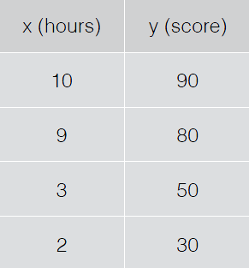
Predicting exam score: regression

Slide 8
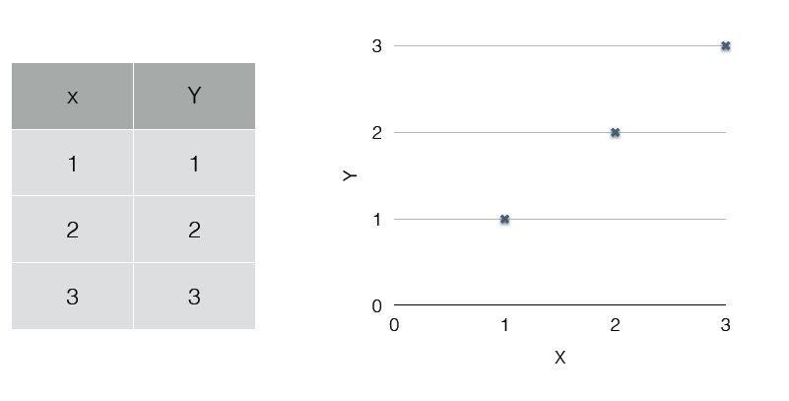
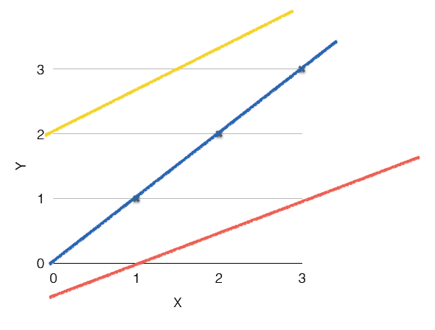
(Linear) Hypothesis
H(x)=Wx+b

Slide 9
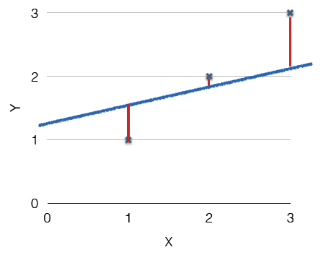
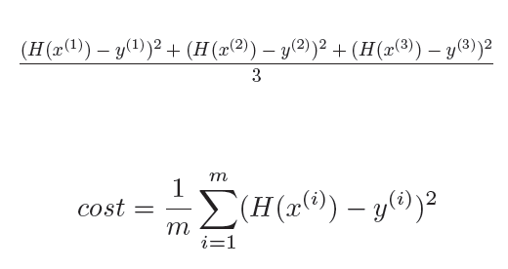
Cost function
Which hypothesis is better?
How fit the line to our (training) data
H(x)-y

Slide 10
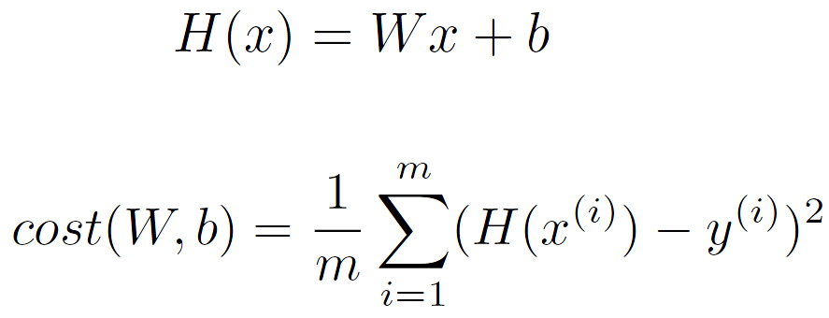
Hypothesis and Cost
Goal: Minimize cost

Slide 11
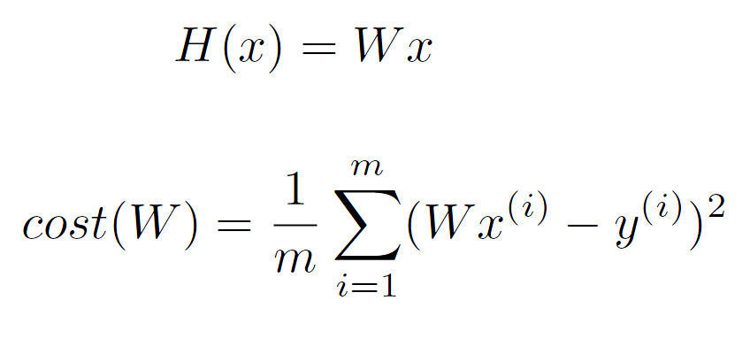
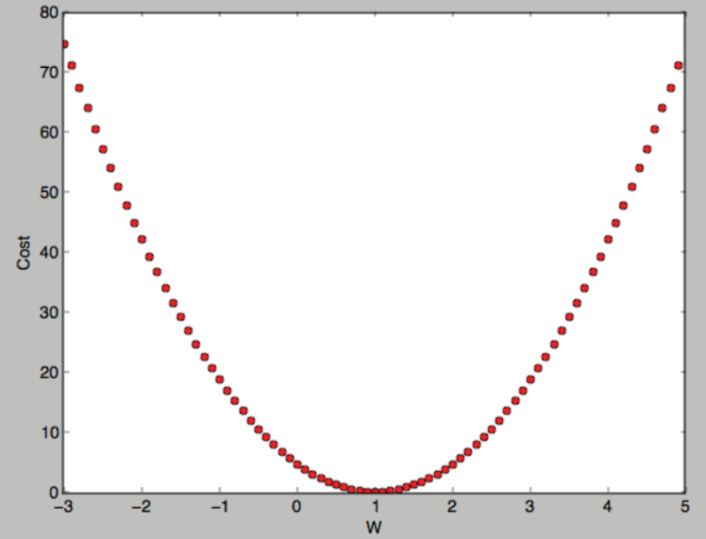
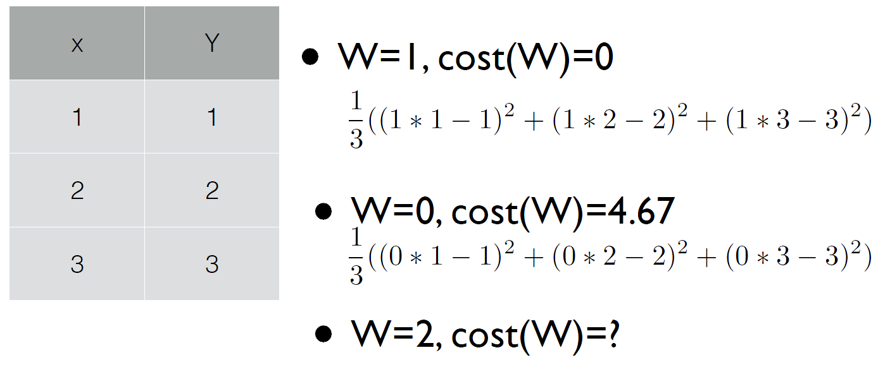
What cost looks like?
Simplified hypothesis
How to minimize cost?

Slide 12
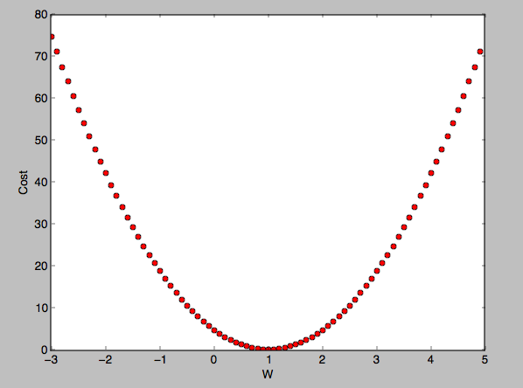
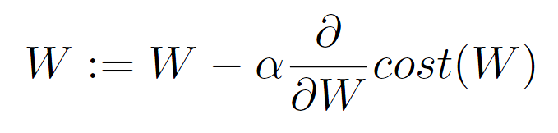
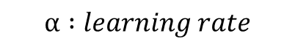
Gradient descent algorithm
Minimize cost function
Start with initial guesses
Start at 0,0 (or any other value)
Keeping changing W and b a little bit to try and reduce cost(W, b)
Each time you change the parameters, you select the gradient which reduces cost(W, b) the most possible
Repeat

Slide 13
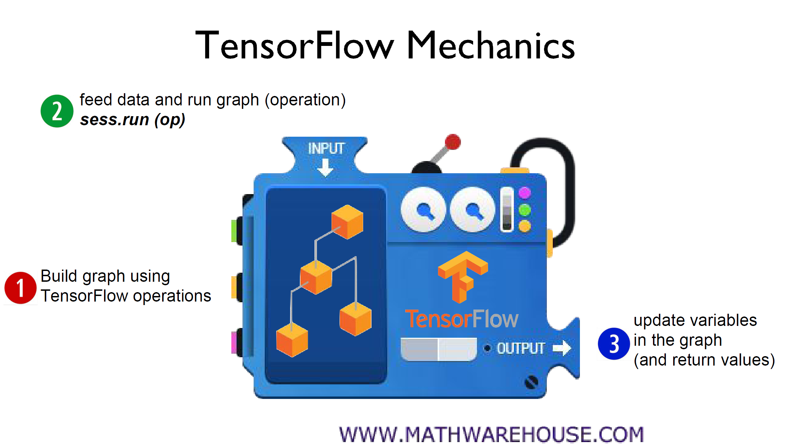

Slide 14
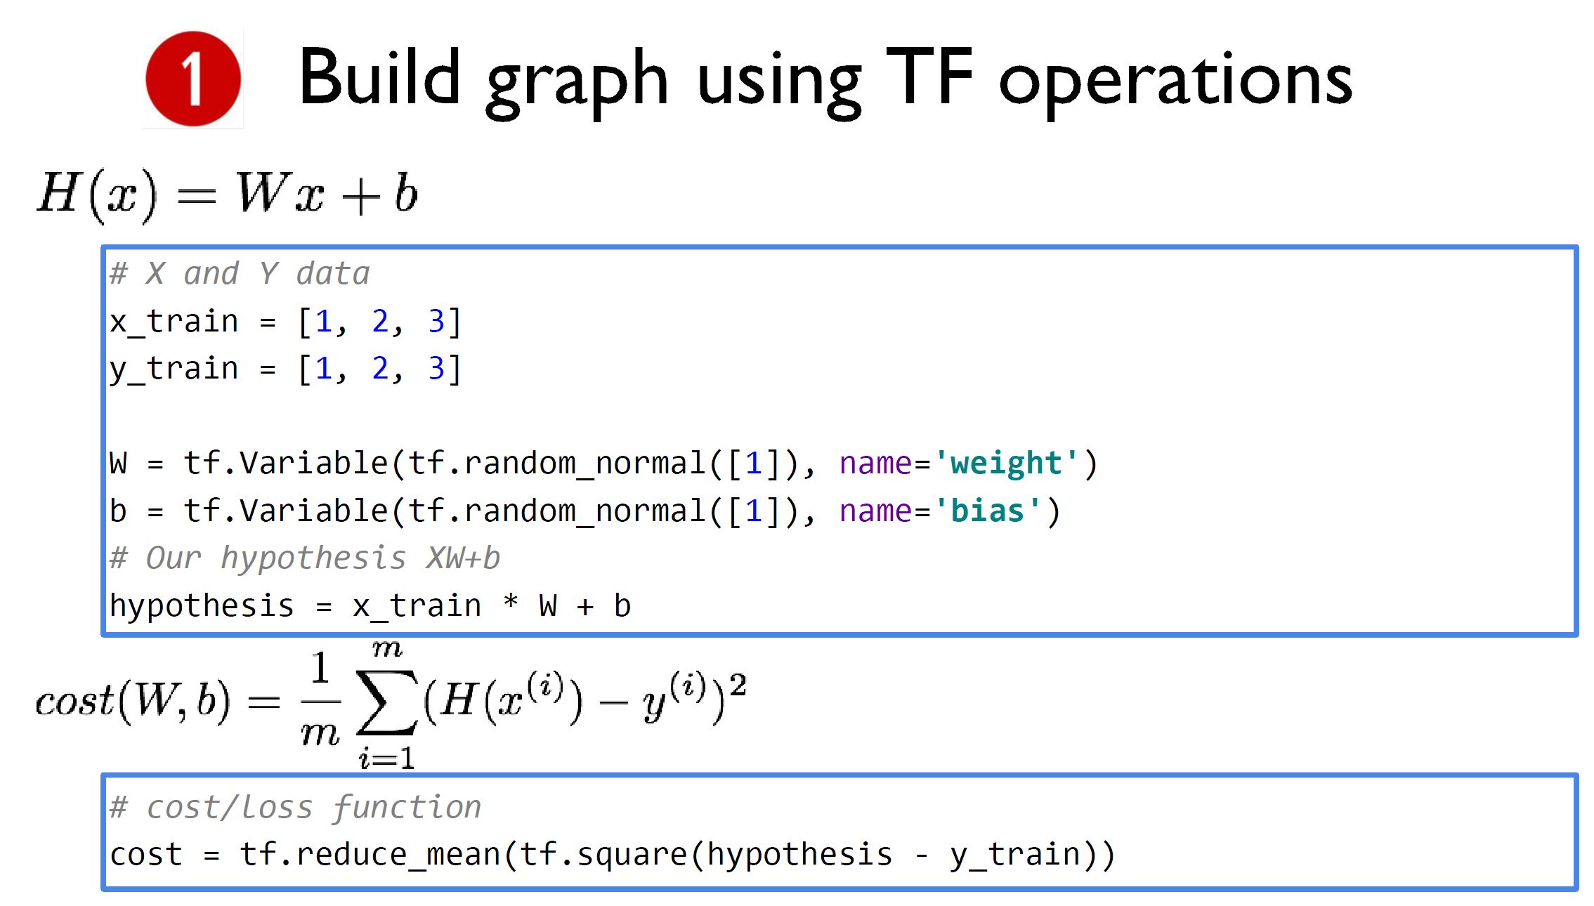

Slide 15
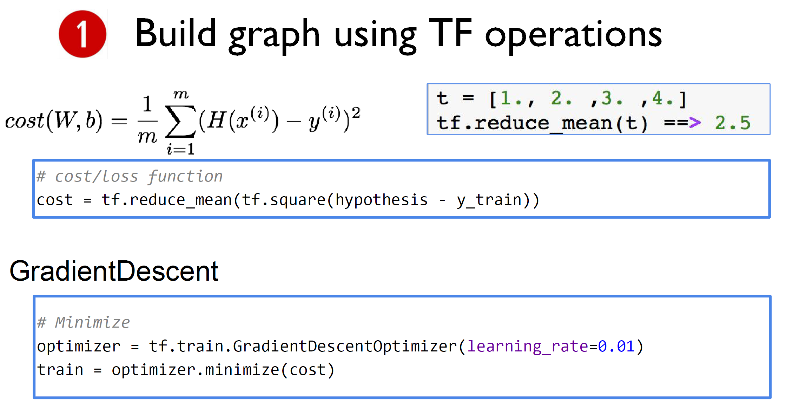

Slide 16
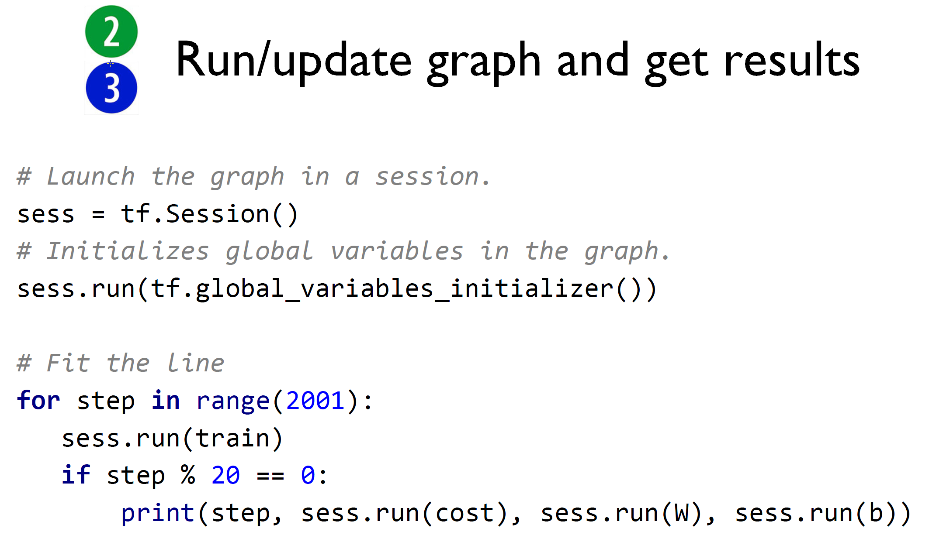

Slide 17
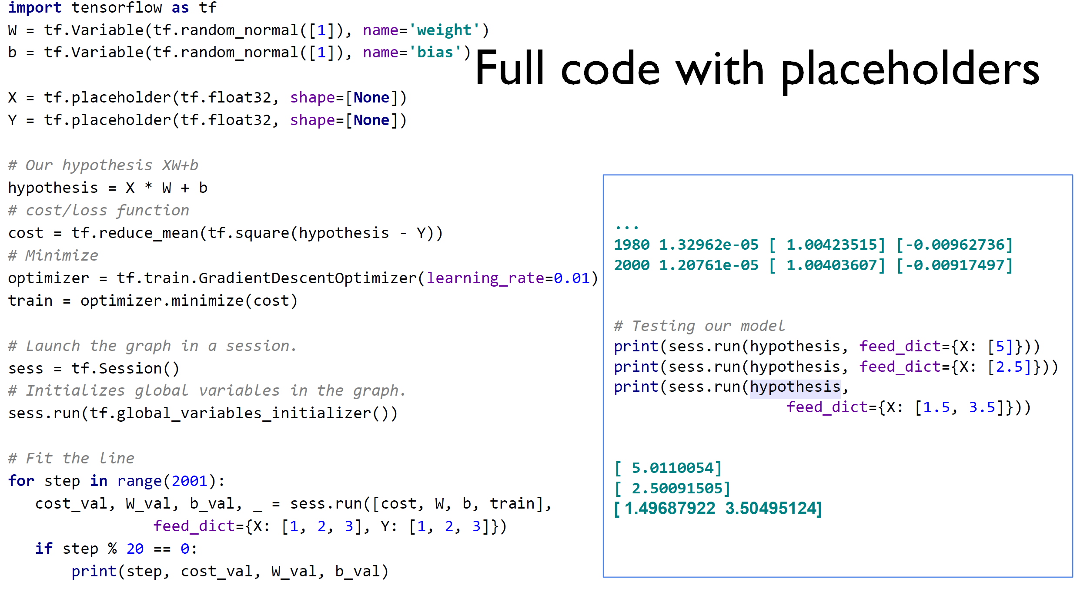

Slide 18
Predicting exam score:
regression using three inputs (x1, x2, x3)
multi-variable feature
x₁ (quiz 1) | x₂ (quiz 2) | x₃ (midterm 1) | Y (final)
73 | 80 | 75 | 152
93 | 88 | 93 | 185
89 | 91 | 90 | 180
96 | 98 | 100 | 196
73 | 66 | 70 | 142
Test Scores for General Psychology

Slide 19
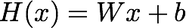
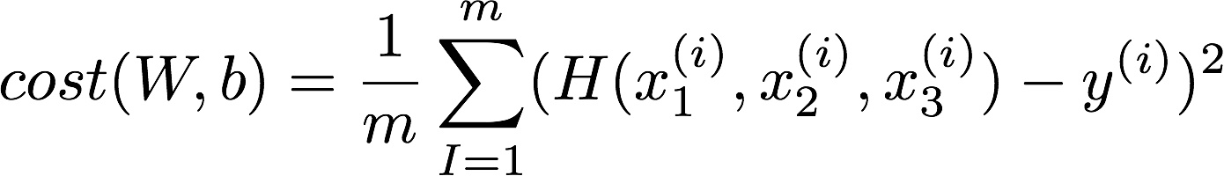
Multi-variable
Hypothesis
Cost function

Slide 20
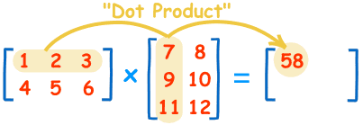
Matrix multiplication
[2X3]
[3X2]
[2X2]
https://www.mathsisfun.com/algebra/matrix-multiplying.html

Slide 21
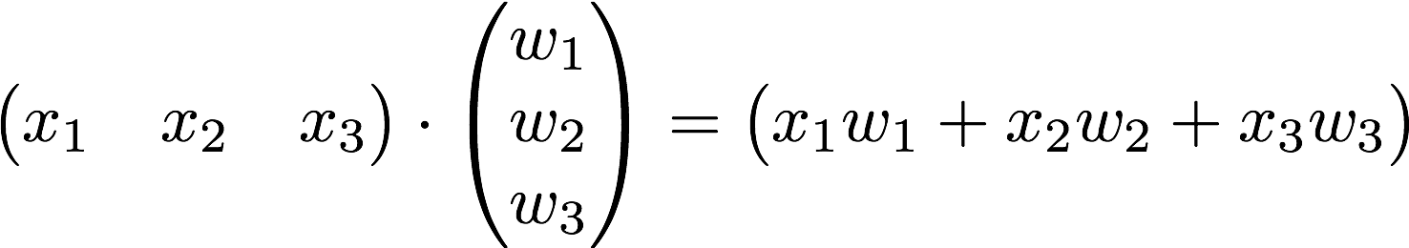
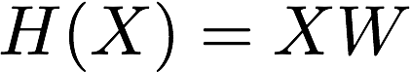
Hypothesis using matrix for multivariable
x₁ | x₂ | x₃ | Y
73 | 80 | 75 | 152
93 | 88 | 93 | 185
89 | 91 | 90 | 180
96 | 98 | 100 | 196
73 | 66 | 70 | 142
Test Scores for General Psychology
Many x instances
https://www.symbolab.com/solver/matrix-calculator
Notes:
\begin{pmatrix}x_1&x_2&x_3\end{pmatrix}\cdot \begin{pmatrix}w_1\\ w_2\\ w_3\end{pmatrix}=\begin{pmatrix}x_1w_1+x_2w_2+x_3w_3\end{pmatrix}

Slide 22
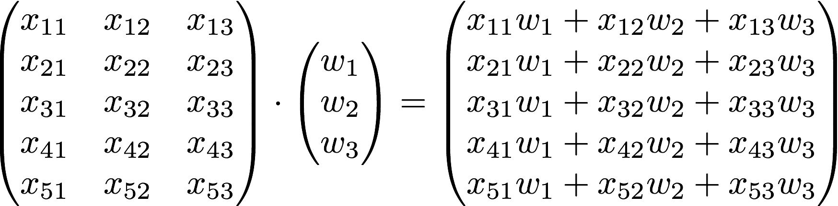
Hypothesis using matrix
x₁ | x₂ | x₃ | Y
73 | 80 | 75 | 152
93 | 88 | 93 | 185
89 | 91 | 90 | 180
96 | 98 | 100 | 196
73 | 66 | 70 | 142
https://www.symbolab.com/solver/matrix-calculator
Notes:
\begin{pmatrix}x_1&x_2&x_3\end{pmatrix}\cdot \begin{pmatrix}w_1\\ w_2\\ w_3\end{pmatrix}=\begin{pmatrix}x_1w_1+x_2w_2+x_3w_3\end{pmatrix}

Slide 23
Hypothesis using matrix
[n, 3]
[3, 1]
[n, 1]
https://www.symbolab.com/solver/matrix-calculator
Notes:
\begin{pmatrix}x_1&x_2&x_3\end{pmatrix}\cdot \begin{pmatrix}w_1\\ w_2\\ w_3\end{pmatrix}=\begin{pmatrix}x_1w_1+x_2w_2+x_3w_3\end{pmatrix}

Slide 24
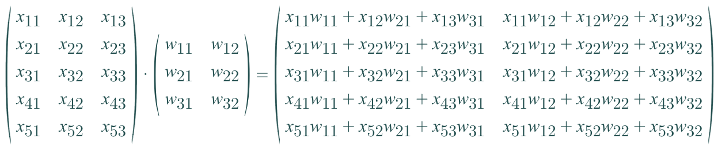
Hypothesis using matrix (n output)
?
[n, 3]
[?, ?]
[n, 2]
https://www.symbolab.com/solver/matrix-calculator
Notes:
\begin{pmatrix}x_1&x_2&x_3\end{pmatrix}\cdot \begin{pmatrix}w_1\\ w_2\\ w_3\end{pmatrix}=\begin{pmatrix}x_1w_1+x_2w_2+x_3w_3\end{pmatrix}

Slide 25
Hypothesis using matrix (n output)
[n, 3]
[3, 2]
[n, 2]
https://www.symbolab.com/solver/matrix-calculator
Notes:
\begin{pmatrix}x_1&x_2&x_3\end{pmatrix}\cdot \begin{pmatrix}w_1\\ w_2\\ w_3\end{pmatrix}=\begin{pmatrix}x_1w_1+x_2w_2+x_3w_3\end{pmatrix}

Slide 26
Binary classification
Spam Detection: Spam(1) or Ham(0)
Facebook feed: show(1) or hide(0)
Credit Card Fraudulent Transaction detection: legitimate (1)/fraud (0)

Slide 27


Slide 28
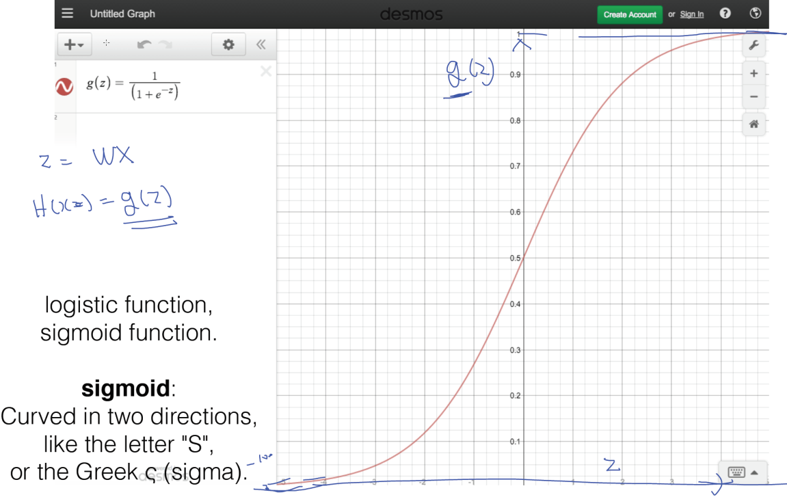
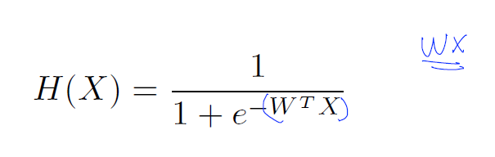
H(x) = Wx+ b (linear regression)
We know Y is 0 or 1
Hypothesis can give values large than 1 or less than 0
→ Logistic Hypothesis

Slide 29
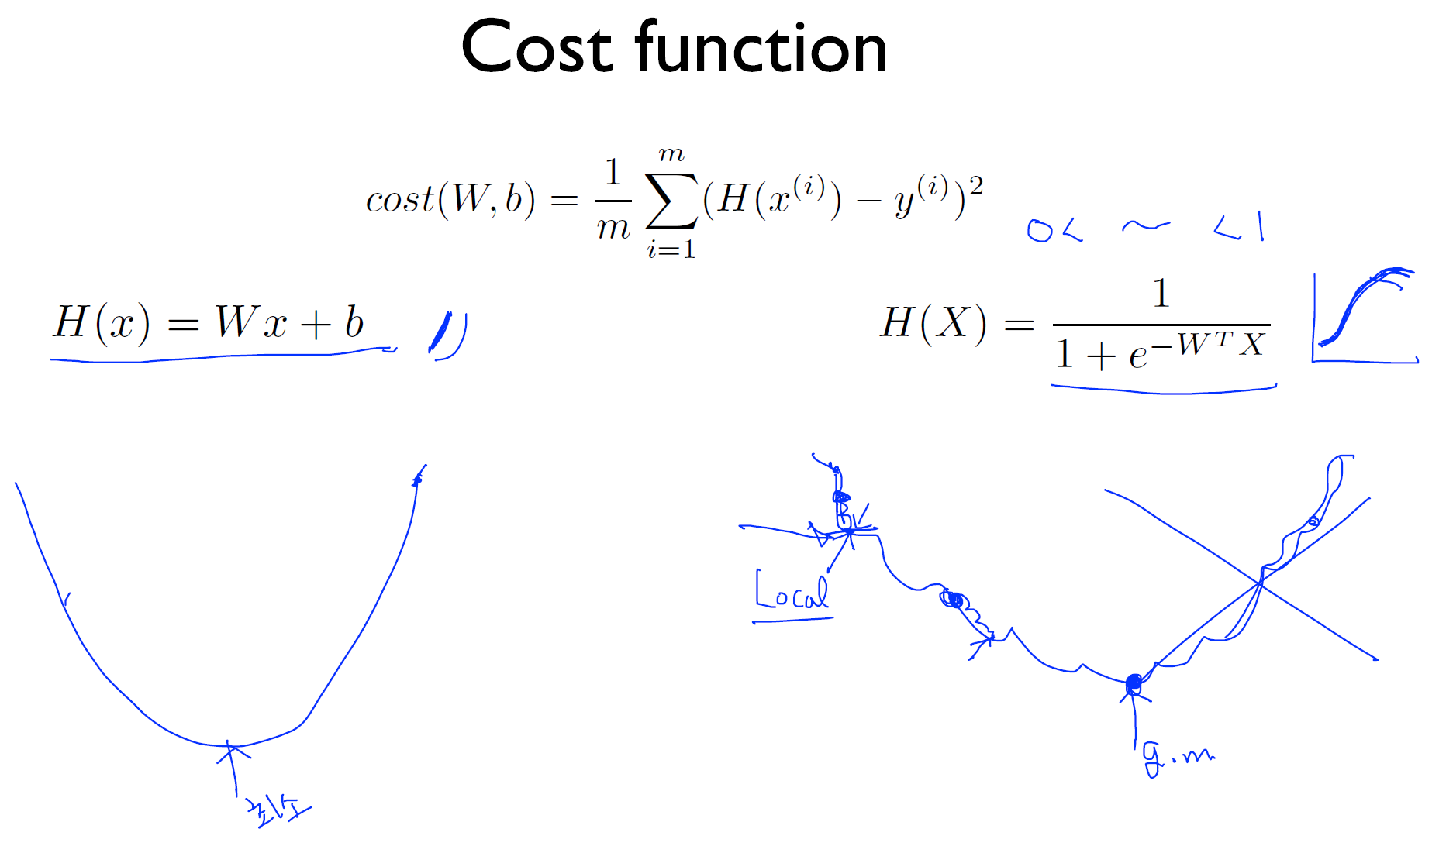

Slide 30
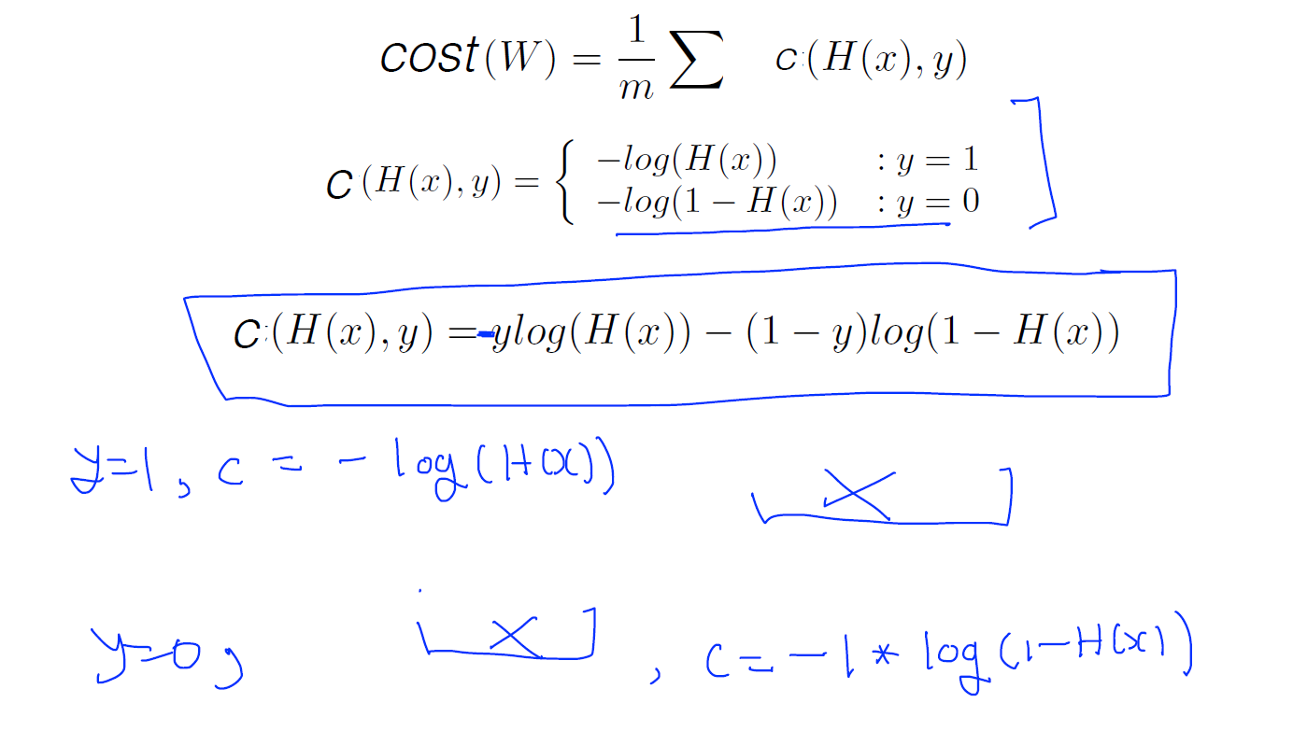
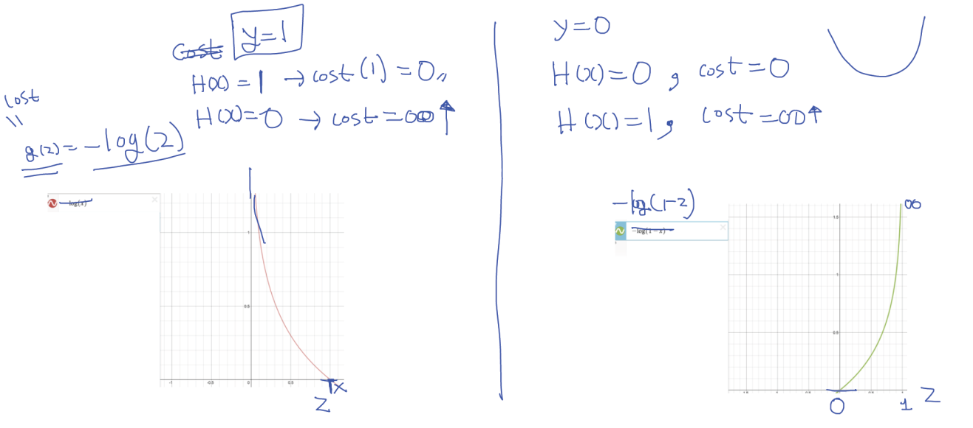
New cost function for logistic

Slide 31
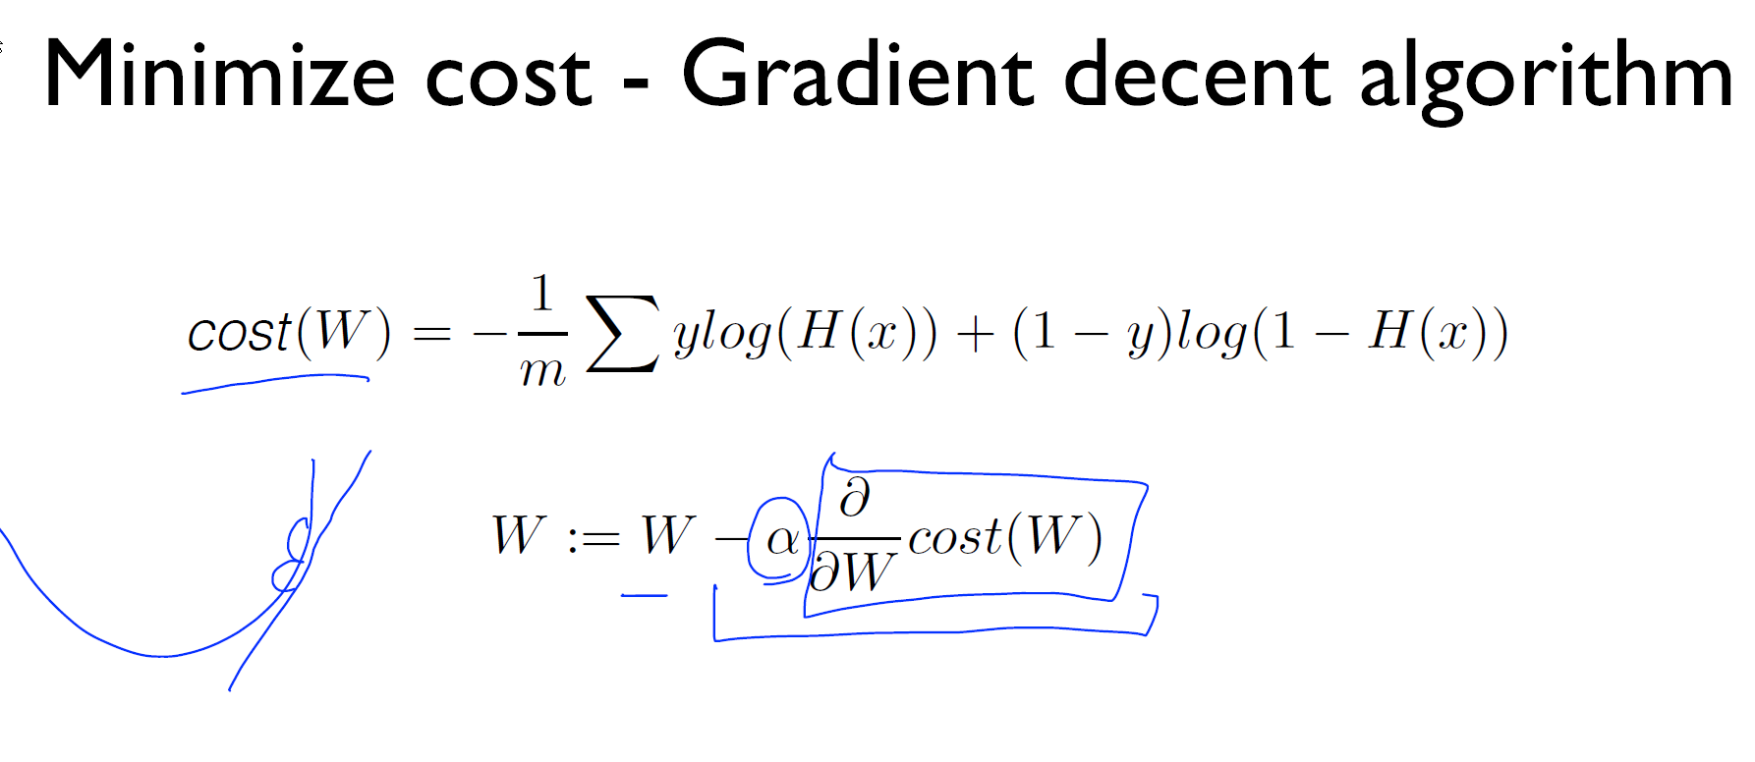
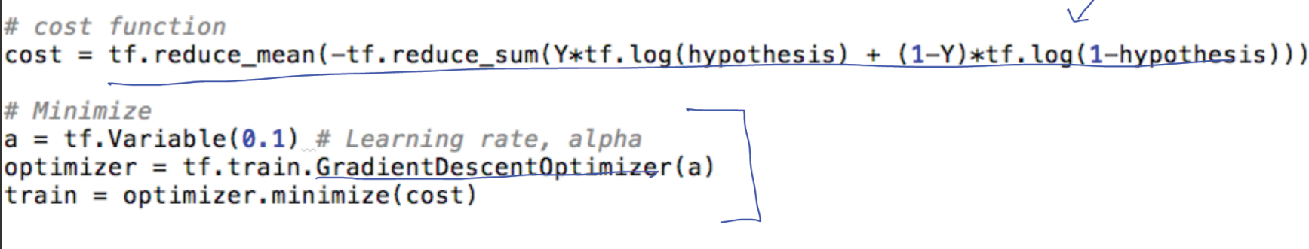
Cross-entropy cost function

Slide 32
* C(H(x), y) = - ylog(H(x)) - (1-y)log(1-H(x)) 이지요? S1를 y=1일 때의 p(x)인 H(x)로 대체하고, 따라서 S0는 y=일 때의 p(x)이므로 1-H(x)가 되겠네요. Li는 y가 1일 때, 0일 대로 나누면 결국 cross entopy는 Logistic cost와 같습니다.

Slide 33
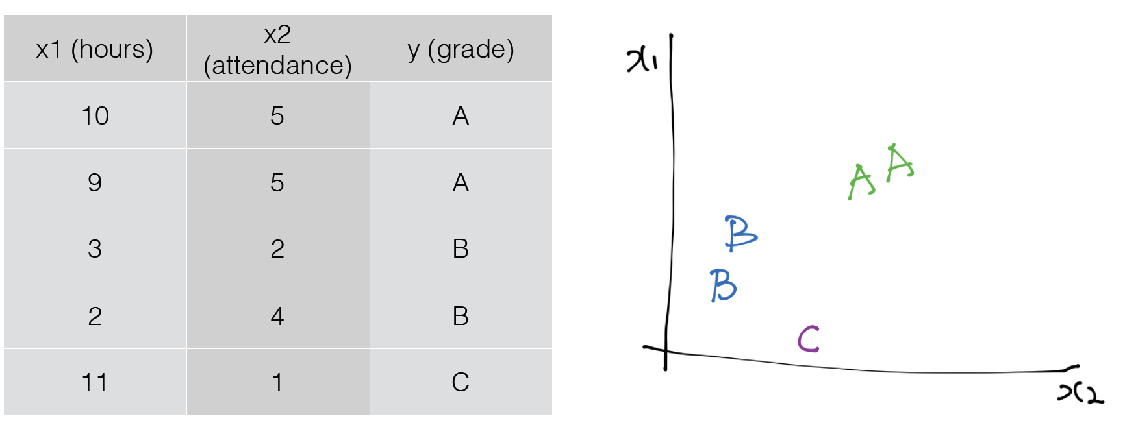
Softmax classification: Multinomial classification

Slide 34
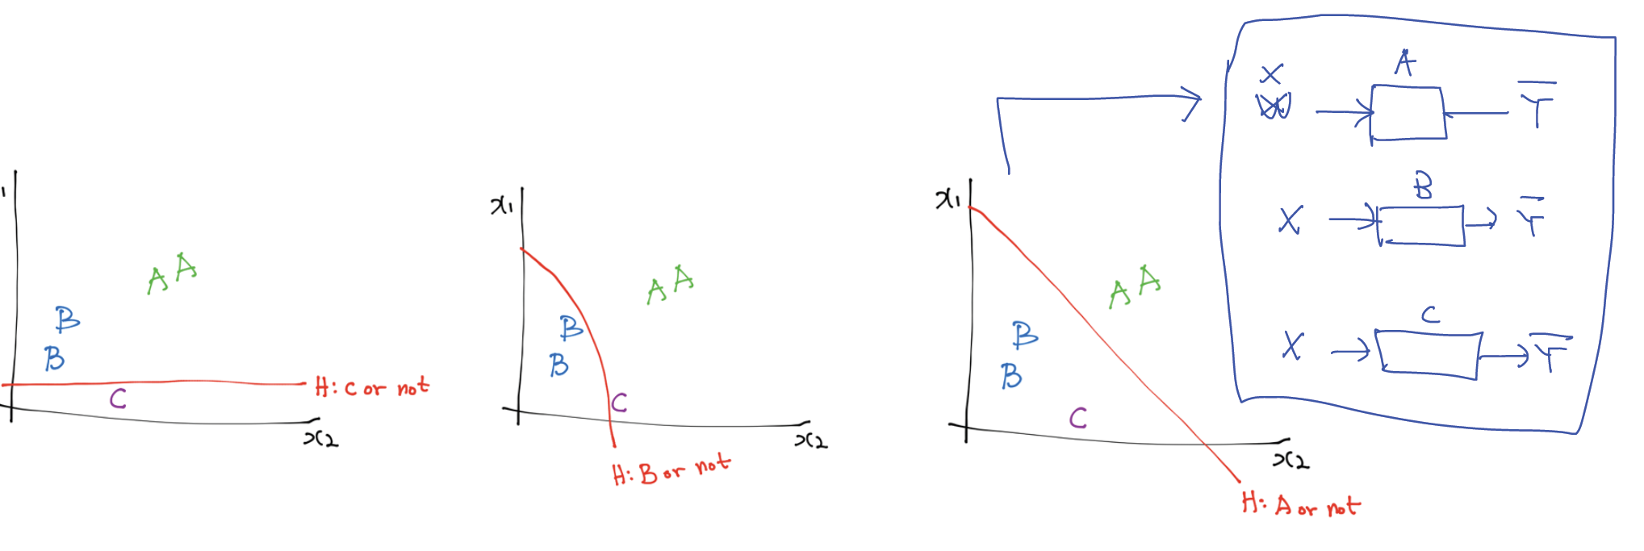
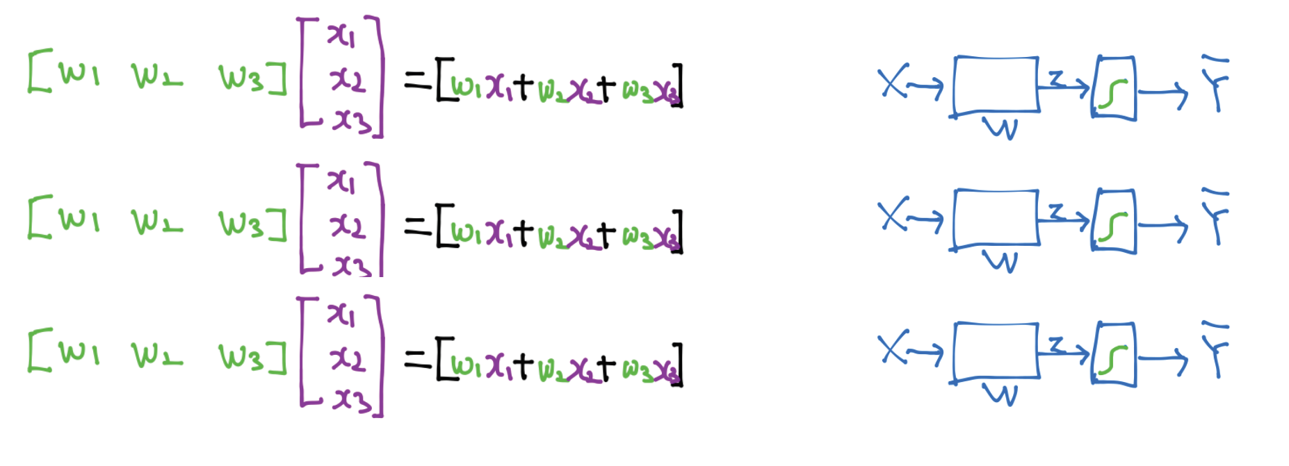

Slide 35
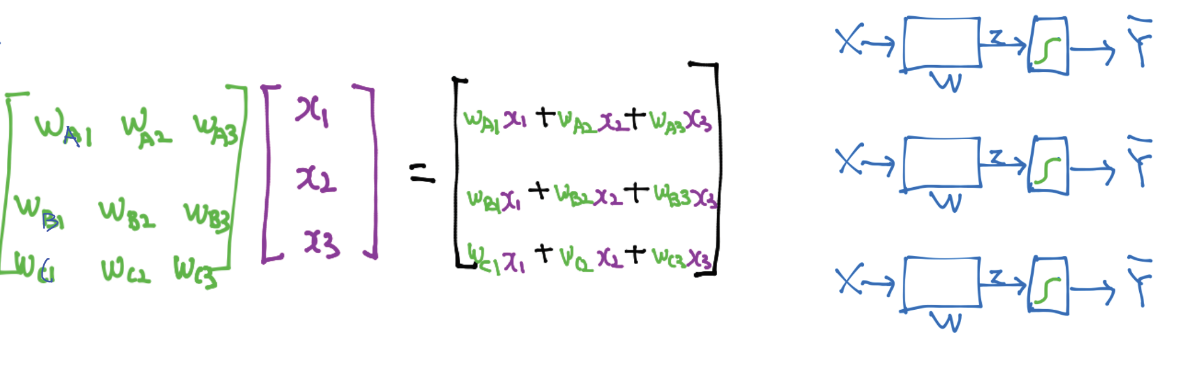

Slide 36
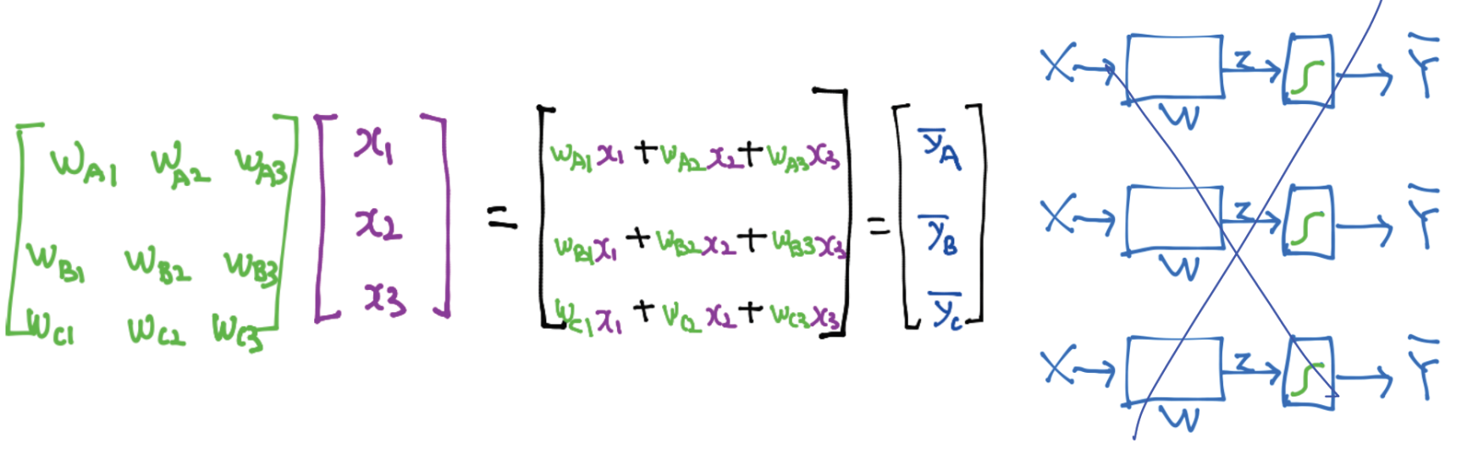
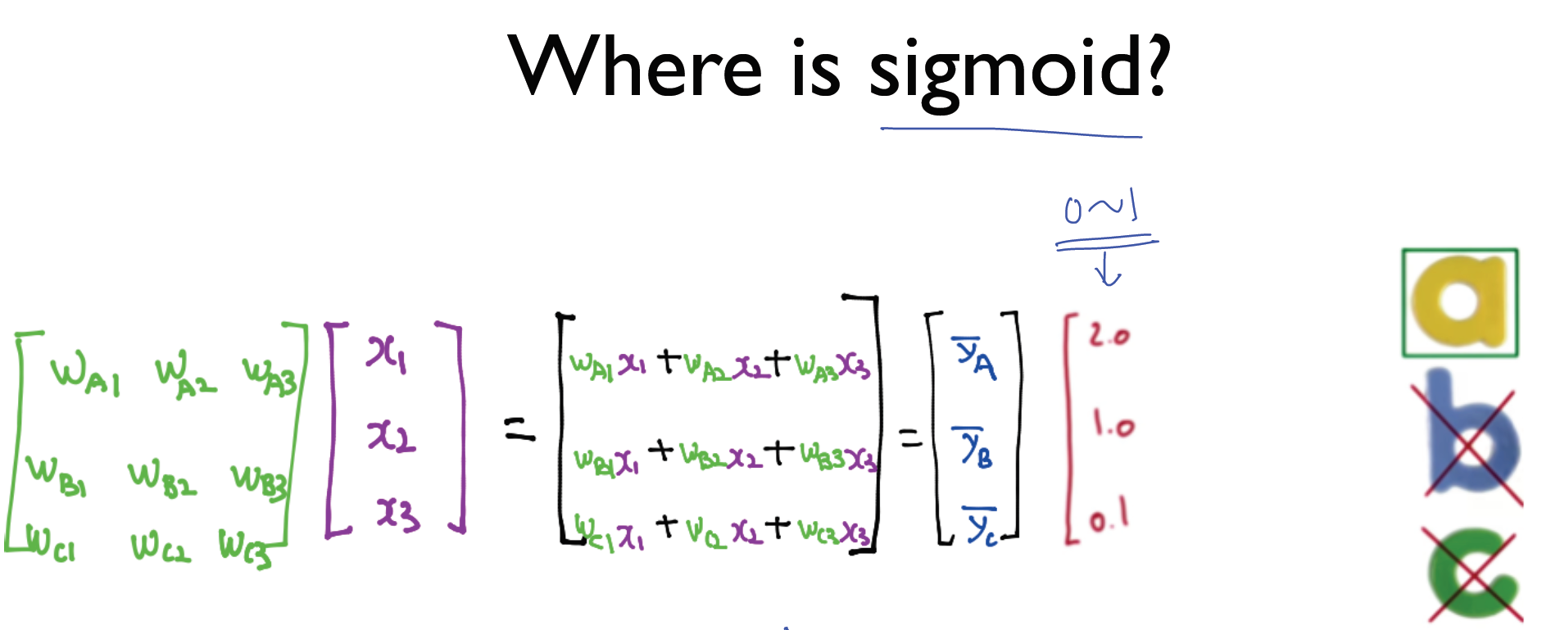

Slide 37
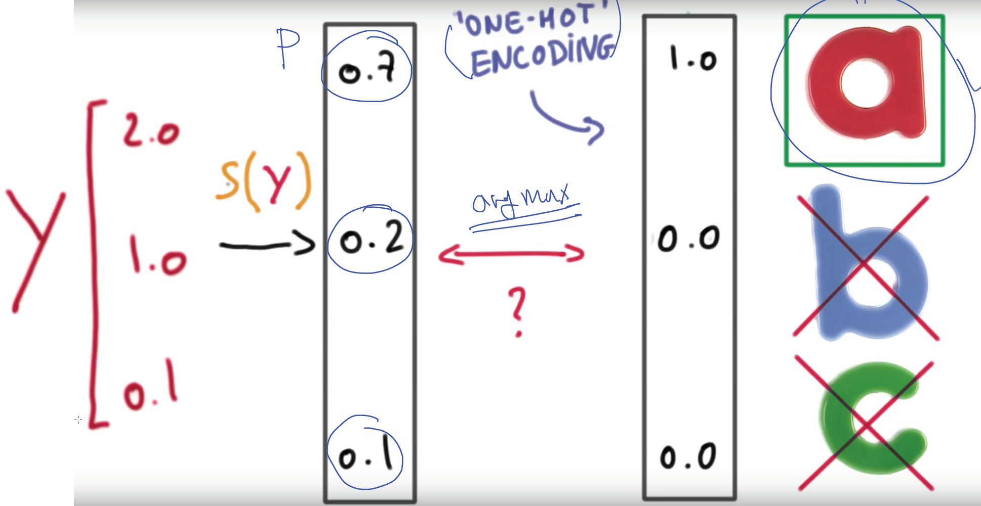
SOFTMAX

Slide 38
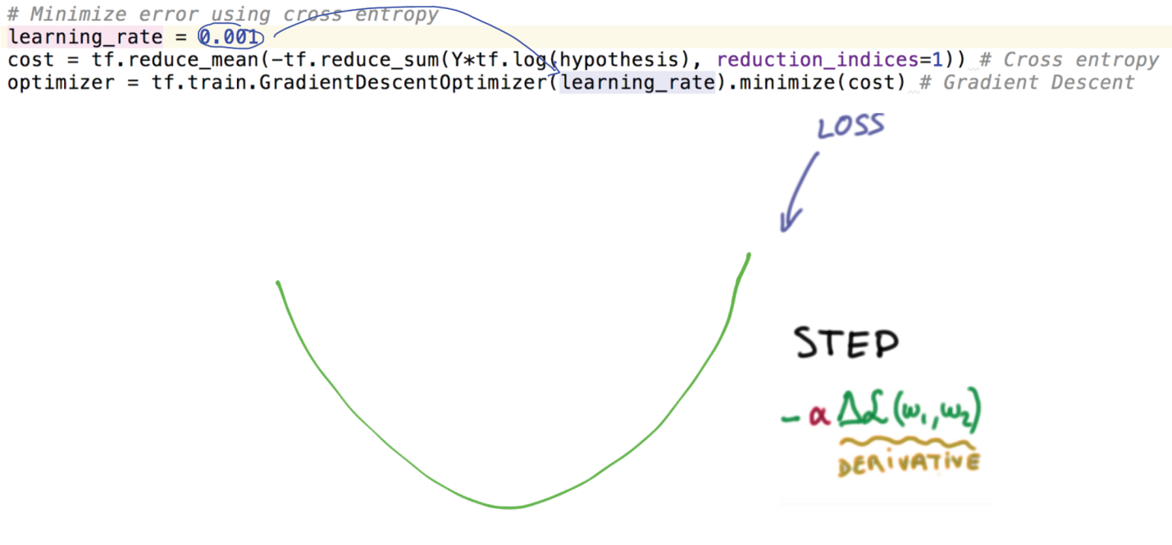
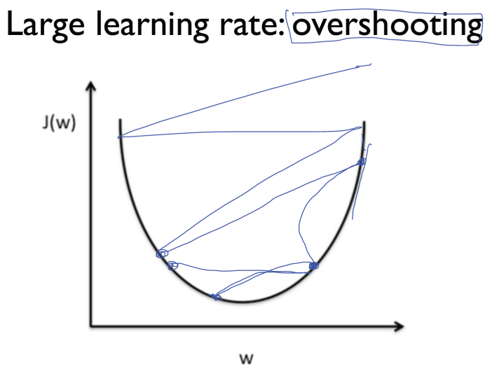
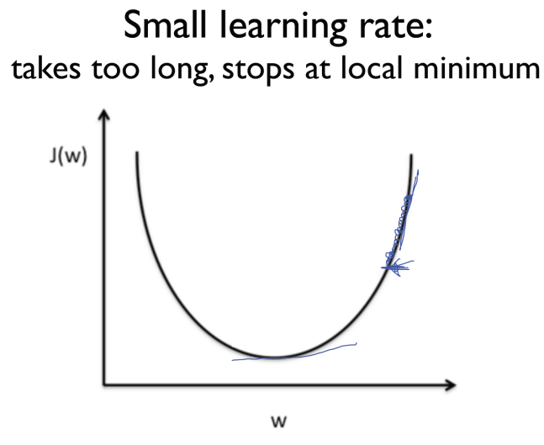
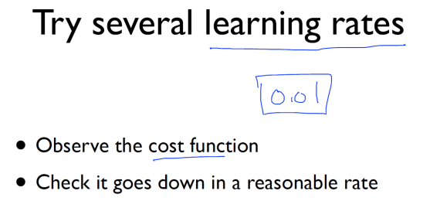
Learning rate

Slide 39
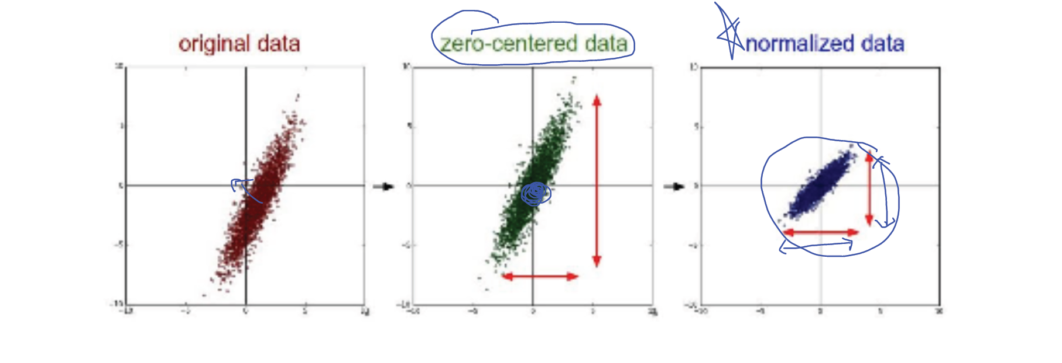
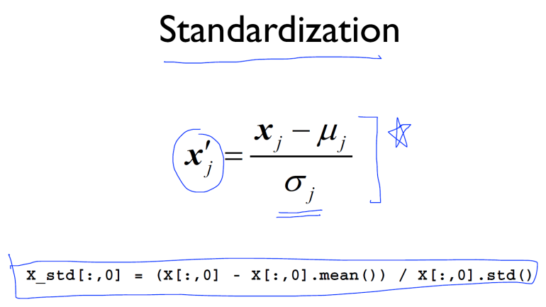
Data(X) preprocessing for gradient descent

Slide 40
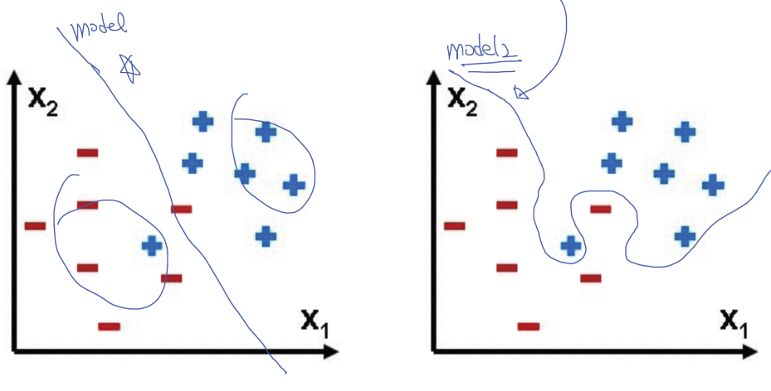
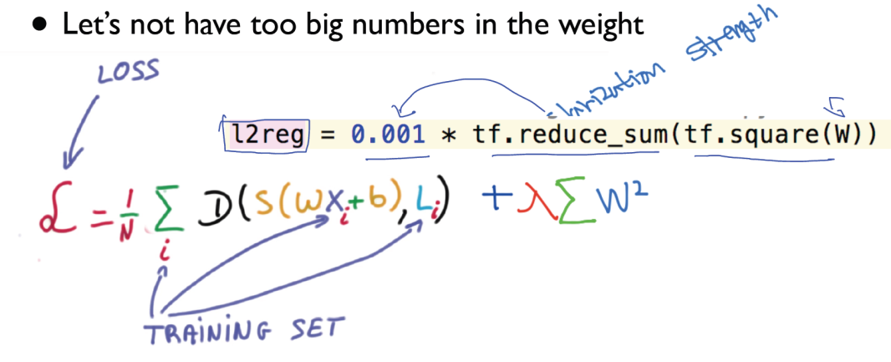
Overfitting
Solutions for overfitting
• More training data!
• Reduce the number of features
• Regularization

Slide 41

Performance evaluation: is this good?

Slide 42


Slide 43


Slide 44


Slide 45


Slide 46


Slide 47


Slide 48


Slide 49


Slide 50
#9-10
Neural net
Back propagation
ReLu (activation function)
Initialize weights in a smart way

Slide 51



Slide 52





Slide 53



Slide 54


Slide 55


Slide 56


Slide 57



Slide 58



Slide 59


Slide 60


Slide 61



Slide 62


Slide 63



Slide 64



Slide 65


Vanishing gradient (NN winter2: 1986-2006)

Slide 66


ReLU: Rectified Linear Unit

Slide 67



Slide 68


Slide 69



Slide 70



Slide 71

Need to set the initial weight values wisely
Not all 0’s
Challenging issue
Hinton et al. (2006) "A Fast Learning Algorithm for Deep Belief Nets”
- Restricted Boatman Machine (RBM)

Slide 72



Slide 73

How can we use RBM to initialize weights? •
Apply the RBM idea on adjacent two layers as a pre-training step
• Continue the first process to all layers
• This will set weights
• Example: Deep Belief Network
- Weight initialized by RBM

Slide 74
Good news
No need to use complicated RBM for weight initializations
• Simple methods are OK
- Xavier initialization: X. Glorot and Y. Bengio, “Understanding the difficulty of training deep feedforward neural networks,” in International conference on artificial intelligence and statistics, 2010
- He’s initialization: K. He, X. Zhang, S. Ren, and J. Sun, “Delving Deep into Rectifiers:
Surpassing Human-Level Performance on ImageNet Classification,” 2015

Slide 75

Xavier/He initialization •
Makes sure the weights are ‘just right’, not too small, not too big
Using number of input (fan_in) and output (fan_out)

Slide 76



Slide 77


NN dropout and model ensemble
Solutions for overfitting
• More training data!
• Reduce the number of features
• Regularization
Test error
Training error

Slide 78

Dropout

Slide 79


Slide 80


Slide 81


Slide 82




Slide 83



Convolutional network

Slide 84


Lab 9-1
NN for XOR
With TF 1.0!
Sung Kim <hunkim+ml@gmail.com>
Code: https://github.com/hunkim/DeepLearningZeroToAll/

Slide 85

https://github.com/hunkim/DeepLearningZeroToAll/

Slide 86

XOR data set
x_data = np.array([[0, 0], [0, 1], [1, 0], [1, 1]], dtype=np.float32)
y_data = np.array([[0], [1], [1], [0]], dtype=np.float32)
http://templ25.mandaringardencity.com/xor-gate-truth-table-2/

Slide 87
XOR with
logistic regression?
But
it doesn’t work
x_data = np.array([[0, 0], [0, 1], [1, 0], [1, 1]], dtype=np.float32)
y_data = np.array([[0], [1], [1], [0]], dtype=np.float32)
X = tf.placeholder(tf.float32)
Y = tf.placeholder(tf.float32)
W = tf.Variable(tf.random_normal([2, 1]), name='weight')
b = tf.Variable(tf.random_normal([1]), name='bias')
# Hypothesis using sigmoid: tf.div(1., 1. + tf.exp(tf.matmul(X, W)))
hypothesis = tf.sigmoid(tf.matmul(X, W) + b)
# cost/loss function
cost = -tf.reduce_mean(Y * tf.log(hypothesis) + (1 - Y) * tf.log(1 - hypothesis))
train = tf.train.GradientDescentOptimizer(learning_rate=0.1).minimize(cost)
# Accuracy computation
# True if hypothesis>0.5 else False
predicted = tf.cast(hypothesis > 0.5, dtype=tf.float32)
accuracy = tf.reduce_mean(tf.cast(tf.equal(predicted, Y), dtype=tf.float32))
# Launch graph
with tf.Session() as sess:
# Initialize TensorFlow variables
sess.run(tf.global_variables_initializer())
for step in range(10001):
sess.run(train, feed_dict={X: x_data, Y: y_data})
if step % 100 == 0:
print(step, sess.run(cost, feed_dict={X: x_data, Y: y_data}), sess.run(W))
# Accuracy report
h, c, a = sess.run([hypothesis, predicted, accuracy], feed_dict={X: x_data, Y: y_data})
print("\nHypothesis: ", h, "\nCorrect: ", c, "\nAccuracy: ", a)
https://github.com/hunkim/DeepLearningZeroToAll/blob/master/lab-09-1-xor.py

Slide 88
XOR with
logistic regression?
But
it doesn’t work!
x_data = np.array([[0, 0], [0, 1], [1, 0], [1, 1]], dtype=np.float32)
y_data = np.array([[0], [1], [1], [0]], dtype=np.float32)
X = tf.placeholder(tf.float32)
Y = tf.placeholder(tf.float32)
W = tf.Variable(tf.random_normal([2, 1]), name='weight')
b = tf.Variable(tf.random_normal([1]), name='bias')
# Hypothesis using sigmoid: tf.div(1., 1. + tf.exp(tf.matmul(X, W)))
hypothesis = tf.sigmoid(tf.matmul(X, W) + b)
# cost/loss function
cost = -tf.reduce_mean(Y * tf.log(hypothesis) + (1 - Y) * tf.log(1 - hypothesis))
train = tf.train.GradientDescentOptimizer(learning_rate=0.1).minimize(cost)
# Accuracy computation
# True if hypothesis>0.5 else False
predicted = tf.cast(hypothesis > 0.5, dtype=tf.float32)
accuracy = tf.reduce_mean(tf.cast(tf.equal(predicted, Y), dtype=tf.float32))
# Launch graph
with tf.Session() as sess:
# Initialize TensorFlow variables
sess.run(tf.global_variables_initializer())
for step in range(10001):
sess.run(train, feed_dict={X: x_data, Y: y_data})
if step % 100 == 0:
print(step, sess.run(cost, feed_dict={X: x_data, Y: y_data}), sess.run(W))
# Accuracy report
h, c, a = sess.run([hypothesis, predicted, accuracy], feed_dict={X: x_data, Y: y_data})
print("\nHypothesis: ", h, "\nCorrect: ", c, "\nAccuracy: ", a)
Hypothesis:
[[ 0.5]
[ 0.5]
[ 0.5]
[ 0.5]]
Correct:
[[ 0.]
[ 0.]
[ 0.]
[ 0.]]
Accuracy: 0.5
https://github.com/hunkim/DeepLearningZeroToAll/blob/master/lab-09-1-xor.py

Slide 89

Neural Net
W = tf.Variable(tf.random_normal([2, 1]), name='weight')
b = tf.Variable(tf.random_normal([1]), name='bias')
# Hypothesis using sigmoid: tf.div(1., 1. + tf.exp(tf.matmul(X, W)))
hypothesis = tf.sigmoid(tf.matmul(X, W) + b)
https://github.com/hunkim/DeepLearningZeroToAll/blob/master/lab-09-1-xor.py

Slide 90
Neural Net
W = tf.Variable(tf.random_normal([2, 1]), name='weight')
b = tf.Variable(tf.random_normal([1]), name='bias')
# Hypothesis using sigmoid: tf.div(1., 1. + tf.exp(tf.matmul(X, W)))
hypothesis = tf.sigmoid(tf.matmul(X, W) + b)
W1 = tf.Variable(tf.random_normal([2, 2]), name='weight1')
b1 = tf.Variable(tf.random_normal([2]), name='bias1')
layer1 = tf.sigmoid(tf.matmul(X, W1) + b1)
W2 = tf.Variable(tf.random_normal([2, 1]), name='weight2')
b2 = tf.Variable(tf.random_normal([1]), name='bias2')
hypothesis = tf.sigmoid(tf.matmul(layer1, W2) + b2)
https://github.com/hunkim/DeepLearningZeroToAll/blob/master/lab-09-2-xor-nn.py

Slide 91
NN for XOR
x_data = np.array([[0, 0], [0, 1], [1, 0], [1, 1]], dtype=np.float32)
y_data = np.array([[0], [1], [1], [0]], dtype=np.float32)
X = tf.placeholder(tf.float32)
Y = tf.placeholder(tf.float32)
W1 = tf.Variable(tf.random_normal([2, 2]), name='weight1')
b1 = tf.Variable(tf.random_normal([2]), name='bias1')
layer1 = tf.sigmoid(tf.matmul(X, W1) + b1)
W2 = tf.Variable(tf.random_normal([2, 1]), name='weight2')
b2 = tf.Variable(tf.random_normal([1]), name='bias2')
hypothesis = tf.sigmoid(tf.matmul(layer1, W2) + b2)
# cost/loss function
cost = -tf.reduce_mean(Y * tf.log(hypothesis) + (1 - Y) * tf.log(1 - hypothesis))
train = tf.train.GradientDescentOptimizer(learning_rate=0.1).minimize(cost)
# Accuracy computation
# True if hypothesis>0.5 else False
predicted = tf.cast(hypothesis > 0.5, dtype=tf.float32)
accuracy = tf.reduce_mean(tf.cast(tf.equal(predicted, Y), dtype=tf.float32))
# Launch graph
with tf.Session() as sess:
# Initialize TensorFlow variables
sess.run(tf.global_variables_initializer())
for step in range(10001):
sess.run(train, feed_dict={X: x_data, Y: y_data})
if step % 100 == 0:
print(step, sess.run(cost, feed_dict={X: x_data, Y: y_data}), sess.run([W1, W2]))
# Accuracy report
h, c, a = sess.run([hypothesis, predicted, accuracy],
feed_dict={X: x_data, Y: y_data})
print("\nHypothesis: ", h, "\nCorrect: ", c, "\nAccuracy: ", a)
Hypothesis:
[[ 0.01338218]
[ 0.98166394]
[ 0.98809403]
[ 0.01135799]]
Correct:
[[ 0.]
[ 1.]
[ 1.]
[ 0.]]
Accuracy: 1.0
https://github.com/hunkim/DeepLearningZeroToAll/blob/master/lab-09-2-xor-nn.py

Slide 92

Wide NN for XOR
W1 = tf.Variable(tf.random_normal([2, 10]), name='weight1')
b1 = tf.Variable(tf.random_normal([10]), name='bias1')
layer1 = tf.sigmoid(tf.matmul(X, W1) + b1)
W2 = tf.Variable(tf.random_normal([10, 1]), name='weight2')
b2 = tf.Variable(tf.random_normal([1]), name='bias2')
hypothesis = tf.sigmoid(tf.matmul(layer1, W2) + b2)
[2,10], [10,1]
Hypothesis:
[[ 0.00358802]
[ 0.99366933]
[ 0.99204296]
[ 0.0095663 ]]
Correct:
[[ 0.]
[ 1.]
[ 1.]
[ 0.]]
Accuracy: 1.0
[2,2], [2,1]
Hypothesis:
[[ 0.01338218]
[ 0.98166394]
[ 0.98809403]
[ 0.01135799]]
Correct:
[[ 0.]
[ 1.]
[ 1.]
[ 0.]]
Accuracy: 1.0
https://github.com/hunkim/DeepLearningZeroToAll/blob/master/lab-09-3-xor-nn-wide-deep.py

Slide 93

Deep NN for XOR
W1 = tf.Variable(tf.random_normal([2, 10]), name='weight1')
b1 = tf.Variable(tf.random_normal([10]), name='bias1')
layer1 = tf.sigmoid(tf.matmul(X, W1) + b1)
W2 = tf.Variable(tf.random_normal([10, 10]), name='weight2')
b2 = tf.Variable(tf.random_normal([10]), name='bias2')
layer2 = tf.sigmoid(tf.matmul(layer1, W2) + b2)
W3 = tf.Variable(tf.random_normal([10, 10]), name='weight3')
b3 = tf.Variable(tf.random_normal([10]), name='bias3')
layer3 = tf.sigmoid(tf.matmul(layer2, W3) + b3)
W4 = tf.Variable(tf.random_normal([10, 1]), name='weight4')
b4 = tf.Variable(tf.random_normal([1]), name='bias4')
hypothesis = tf.sigmoid(tf.matmul(layer3, W4) + b4)
4 layers
Hypothesis:
[[ 7.80e-04]
[ 9.99e-01]
[ 9.98e-01]
[ 1.55e-03]]
Correct:
[[ 0.]
[ 1.]
[ 1.]
[ 0.]]
Accuracy: 1.0
2 layers
Hypothesis:
[[ 0.01338218]
[ 0.98166394]
[ 0.98809403]
[ 0.01135799]]
Correct:
[[ 0.]
[ 1.]
[ 1.]
[ 0.]]
Accuracy: 1.0
https://github.com/hunkim/DeepLearningZeroToAll/blob/master/lab-09-3-xor-nn-wide-deep.py

Slide 94
Lab 9-2
Tensorboard for XOR NN
With TF 1.0!
Sung Kim <hunkim+ml@gmail.com>
Code: https://github.com/hunkim/DeepLearningZeroToAll/

Slide 95

TensorBoard: TF logging/debugging tool
Visualize your TF graph
Plot quantitative metrics
Show additional data
https://www.tensorflow.org/get_started/summaries_and_tensorboard

Slide 96
Old fashion: print, print, print
9400 0.0151413 [array([[ 6.21692038, 6.05913448],
[-6.33773184, -5.75189114]], dtype=float32), array([[ 9.93581772],
[-9.43034935]], dtype=float32)]
9500 0.014909 [array([[ 6.22498751, 6.07049847],
[-6.34637976, -5.76352596]], dtype=float32), array([[ 9.96414757],
[-9.45942593]], dtype=float32)]
9600 0.0146836 [array([[ 6.23292685, 6.08166742],
[-6.35489035, -5.77496052]], dtype=float32), array([[ 9.99207973],
[-9.48807526]], dtype=float32)]
9700 0.0144647 [array([[ 6.24074268, 6.09264851],
[-6.36326933, -5.78619957]], dtype=float32), array([[ 10.01962471],
[ -9.51631165]], dtype=float32)]
9800 0.0142521 [array([[ 6.24843407, 6.10344648],
[-6.37151814, -5.79724932]], dtype=float32), array([[ 10.04679298],
[ -9.54414845]], dtype=float32)]
9900 0.0140456 [array([[ 6.25601053, 6.11406422],
[-6.3796401 , -5.80811596]], dtype=float32), array([[ 10.07359505],
[ -9.57159519]], dtype=float32)]
10000 0.0138448 [array([[ 6.26347113, 6.12451124],
[-6.38764334, -5.81880617]], dtype=float32), array([[ 10.10004139],
[ -9.59866238]], dtype=float32)]

Slide 97
New way!
step

Slide 98





5 steps of using TensorBoard
From TF graph, decide which tensors you want to log
w2_hist = tf.summary.histogram("weights2", W2)
cost_summ = tf.summary.scalar("cost", cost)
Merge all summaries
summary = tf.summary.merge_all()
Create writer and add graph
# Create summary writer
writer = tf.summary.FileWriter(‘./logs’)
writer.add_graph(sess.graph)
Run summary merge and add_summary
s, _ = sess.run([summary, optimizer], feed_dict=feed_dict)
writer.add_summary(s, global_step=global_step)
Launch TensorBoard
tensorboard --logdir=./logs

Slide 99

Scalar tensors
cost_summ = tf.summary.scalar("cost", cost)

Slide 100

Histogram (multi-dimensional tensors)
W2 = tf.Variable(tf.random_normal([2, 1]), name='weight2')
b2 = tf.Variable(tf.random_normal([1]), name='bias2')
hypothesis = tf.sigmoid(tf.matmul(layer1, W2) + b2)
w2_hist = tf.summary.histogram("weights2", W2)
b2_hist = tf.summary.histogram("biases2", b2)
hypothesis_hist = tf.summary.histogram("hypothesis", hypothesis)
step
w
https://github.com/hunkim/DeepLearningZeroToAll/blob/master/lab-09-4-xor_tensorboard.py

Slide 101

Add scope for better
graph hierarchy
with tf.name_scope("layer1") as scope:
W1 = tf.Variable(tf.random_normal([2, 2]), name='weight1')
b1 = tf.Variable(tf.random_normal([2]), name='bias1')
layer1 = tf.sigmoid(tf.matmul(X, W1) + b1)
w1_hist = tf.summary.histogram("weights1", W1)
b1_hist = tf.summary.histogram("biases1", b1)
layer1_hist = tf.summary.histogram("layer1", layer1)
with tf.name_scope("layer2") as scope:
W2 = tf.Variable(tf.random_normal([2, 1]), name='weight2')
b2 = tf.Variable(tf.random_normal([1]), name='bias2')
hypothesis = tf.sigmoid(tf.matmul(layer1, W2) + b2)
w2_hist = tf.summary.histogram("weights2", W2)
b2_hist = tf.summary.histogram("biases2", b2)
hypothesis_hist = tf.summary.histogram("hypothesis", hypothesis)
https://github.com/hunkim/DeepLearningZeroToAll/blob/master/lab-09-4-xor_tensorboard.py

Slide 102
Merge summaries and create writer
after creating session
# Summary
summary = tf.summary.merge_all()
# initialize
sess = tf.Session()
sess.run(tf.global_variables_initializer())
# Create summary writer
writer = tf.summary.FileWriter(TB_SUMMARY_DIR)
writer.add_graph(sess.graph) # Add graph in the tensorboard
https://github.com/hunkim/DeepLearningZeroToAll/blob/master/lab-09-4-xor_tensorboard.py

Slide 103
Run merged summary and write (add summary)
s, _ = sess.run([summary, optimizer], feed_dict=feed_dict)
writer.add_summary(s, global_step=global_step)
global_step += 1
https://github.com/hunkim/DeepLearningZeroToAll/blob/master/lab-09-4-xor_tensorboard.py

Slide 104
Launch tensorboard (local)
writer = tf.summary.FileWriter("./logs/xor_logs")
$ tensorboard —logdir=./logs/xor_logs
Starting TensorBoard b'41' on port 6006
(You can navigate to http://127.0.0.1:6006)

Slide 105
Launch tensorboard (remote server)
ssh -L local_port:127.0.0.1:remote_port username@server.com
(Remote server)
local> $ ssh -L 7007:121.0.0.0:6006 hunkim@server.com
server> $ tensorboard —logdir=./logs/xor_logs
(You can navigate to http://127.0.0.1:7007)

Slide 106


Slide 107

Multiple runs
learning_rate=0.1 VS learning_rate=0.01

Slide 108


Multiple runs
tensorboard —logdir=./logs/xor_logs
train = tf.train.GradientDescentOptimizer(learning_rate=0.1).minimize(cost)
...
writer = tf.summary.FileWriter("./logs/xor_logs")
tensorboard —logdir=./logs/xor_logs_r0_01
train = tf.train.GradientDescentOptimizer(learning_rate=0.01).minimize(cost)
...
writer = tf.summary.FileWriter(“"./logs/xor_logs_r0_01"”)
tensorboard —logdir=./logs

Slide 109
Multiple runs

Slide 110
5 steps of using TensorBoard
From TF graph, decide which tensors you want to log
w2_hist = tf.summary.histogram("weights2", W2)
cost_summ = tf.summary.scalar("cost", cost)
Merge all summaries
summary = tf.summary.merge_all()
Create writer and add graph
# Create summary writer
writer = tf.summary.FileWriter(‘./logs’)
writer.add_graph(sess.graph)
Run summary merge and add_summary
s, _ = sess.run([summary, optimizer], feed_dict=feed_dict)
writer.add_summary(s, global_step=global_step)
Launch TensorBoard
tensorboard --logdir=./logs

Slide 111
Lab 10
NN, ReLu, Xavier, Dropout, and Adam
With TF 1.0!
Sung Kim <hunkim+ml@gmail.com>
Code: https://github.com/hunkim/DeepLearningZeroToAll/

Slide 112
# weights & bias for nn layers
W = tf.Variable(tf.random_normal([784, 10]))
b = tf.Variable(tf.random_normal([10]))
hypothesis = tf.matmul(X, W) + b
# define cost/loss & optimizer
cost = tf.reduce_mean(tf.nn.softmax_cross_entropy_with_logits(logits=hypothesis, labels=Y))
optimizer = tf.train.AdamOptimizer(learning_rate=learning_rate).minimize(cost)
# initialize
sess = tf.Session()
sess.run(tf.global_variables_initializer())
# train my model
for epoch in range(training_epochs):
avg_cost = 0
total_batch = int(mnist.train.num_examples / batch_size)
for i in range(total_batch):
batch_xs, batch_ys = mnist.train.next_batch(batch_size)
feed_dict = {X: batch_xs, Y: batch_ys}
c, _ = sess.run([cost, optimizer], feed_dict=feed_dict)
avg_cost += c / total_batch
print('Epoch:', '%04d' % (epoch + 1), 'cost =', '{:.9f}'.format(avg_cost))
print('Learning Finished!')
# Test model and check accuracy
correct_prediction = tf.equal(tf.argmax(hypothesis, 1), tf.argmax(Y, 1))
accuracy = tf.reduce_mean(tf.cast(correct_prediction, tf.float32))
print('Accuracy:', sess.run(accuracy, feed_dict={X: mnist.test.images, Y: mnist.test.labels}))
Softmax classifier for MNIST
Epoch: 0001 cost = 5.888845987
Epoch: 0002 cost = 1.860620173
Epoch: 0003 cost = 1.159035648
Epoch: 0004 cost = 0.892340870
Epoch: 0005 cost = 0.751155428
Epoch: 0006 cost = 0.662484806
Epoch: 0007 cost = 0.601544010
Epoch: 0008 cost = 0.556526115
Epoch: 0009 cost = 0.521186961
Epoch: 0010 cost = 0.493068354
Epoch: 0011 cost = 0.469686249
Epoch: 0012 cost = 0.449967254
Epoch: 0013 cost = 0.433519321
Epoch: 0014 cost = 0.419000337
Epoch: 0015 cost = 0.406490815
Learning Finished!
Accuracy: 0.9035
https://github.com/hunkim/DeepLearningZeroToAll/blob/master/lab-10-1-mnist_softmax.py

Slide 113
# input place holders
X = tf.placeholder(tf.float32, [None, 784])
Y = tf.placeholder(tf.float32, [None, 10])
# weights & bias for nn layers
W1 = tf.Variable(tf.random_normal([784, 256]))
b1 = tf.Variable(tf.random_normal([256]))
L1 = tf.nn.relu(tf.matmul(X, W1) + b1)
W2 = tf.Variable(tf.random_normal([256, 256]))
b2 = tf.Variable(tf.random_normal([256]))
L2 = tf.nn.relu(tf.matmul(L1, W2) + b2)
W3 = tf.Variable(tf.random_normal([256, 10]))
b3 = tf.Variable(tf.random_normal([10]))
hypothesis = tf.matmul(L2, W3) + b3
# define cost/loss & optimizer
cost = tf.reduce_mean(tf.nn.softmax_cross_entropy_with_logits(
logits=hypothesis, labels=Y))
optimizer = tf.train.AdamOptimizer(learning_rate=learning_rate).minimize(cost)
NN for MNIST
Epoch: 0001 cost = 141.207671860
Epoch: 0002 cost = 38.788445864
Epoch: 0003 cost = 23.977515479
Epoch: 0004 cost = 16.315132428
Epoch: 0005 cost = 11.702554882
Epoch: 0006 cost = 8.573139748
Epoch: 0007 cost = 6.370995680
Epoch: 0008 cost = 4.537178684
Epoch: 0009 cost = 3.216900532
Epoch: 0010 cost = 2.329708954
Epoch: 0011 cost = 1.715552875
Epoch: 0012 cost = 1.189857912
Epoch: 0013 cost = 0.820965160
Epoch: 0014 cost = 0.624131458
Epoch: 0015 cost = 0.454633765
Learning Finished!
Accuracy: 0.9455
https://github.com/hunkim/DeepLearningZeroToAll/blob/master/lab-10-2-mnist_nn.py

Slide 114


http://stackoverflow.com/questions/33640581/how-to-do-xavier-initialization-on-tensorflow

Slide 115
# input place holders
X = tf.placeholder(tf.float32, [None, 784])
Y = tf.placeholder(tf.float32, [None, 10])
# weights & bias for nn layers
# http://stackoverflow.com/questions/33640581
W1 = tf.get_variable("W1", shape=[784, 256],
initializer=tf.contrib.layers.xavier_initializer())
b1 = tf.Variable(tf.random_normal([256]))
L1 = tf.nn.relu(tf.matmul(X, W1) + b1)
W2 = tf.get_variable("W2", shape=[256, 256],
initializer=tf.contrib.layers.xavier_initializer())
b2 = tf.Variable(tf.random_normal([256]))
L2 = tf.nn.relu(tf.matmul(L1, W2) + b2)
W3 = tf.get_variable("W3", shape=[256, 10],
initializer=tf.contrib.layers.xavier_initializer())
b3 = tf.Variable(tf.random_normal([10]))
hypothesis = tf.matmul(L2, W3) + b3
# define cost/loss & optimizer
cost = tf.reduce_mean(tf.nn.softmax_cross_entropy_with_logits(
logits=hypothesis, labels=Y))
optimizer = tf.train.AdamOptimizer(learning_rate=learning_rate).minimize(cost)
Xavier for MNIST
Epoch: 0001 cost = 0.301498963
Epoch: 0002 cost = 0.107252513
Epoch: 0003 cost = 0.064888892
Epoch: 0004 cost = 0.044463030
Epoch: 0005 cost = 0.029951642
Epoch: 0006 cost = 0.020663404
Epoch: 0007 cost = 0.015853033
Epoch: 0008 cost = 0.011764387
Epoch: 0009 cost = 0.008598264
Epoch: 0010 cost = 0.007383116
Epoch: 0011 cost = 0.006839140
Epoch: 0012 cost = 0.004672963
Epoch: 0013 cost = 0.003979437
Epoch: 0014 cost = 0.002714260
Epoch: 0015 cost = 0.004707661
Learning Finished!
Accuracy: 0.9783
https://github.com/hunkim/DeepLearningZeroToAll/blob/master/lab-10-3-mnist_nn_xavier.py

Slide 116
# input place holders
X = tf.placeholder(tf.float32, [None, 784])
Y = tf.placeholder(tf.float32, [None, 10])
# weights & bias for nn layers
# http://stackoverflow.com/questions/33640581
W1 = tf.get_variable("W1", shape=[784, 256],
initializer=tf.contrib.layers.xavier_initializer())
b1 = tf.Variable(tf.random_normal([256]))
L1 = tf.nn.relu(tf.matmul(X, W1) + b1)
W2 = tf.get_variable("W2", shape=[256, 256],
initializer=tf.contrib.layers.xavier_initializer())
b2 = tf.Variable(tf.random_normal([256]))
L2 = tf.nn.relu(tf.matmul(L1, W2) + b2)
W3 = tf.get_variable("W3", shape=[256, 10],
initializer=tf.contrib.layers.xavier_initializer())
b3 = tf.Variable(tf.random_normal([10]))
hypothesis = tf.matmul(L2, W3) + b3
# define cost/loss & optimizer
cost = tf.reduce_mean(tf.nn.softmax_cross_entropy_with_logits(
logits=hypothesis, labels=Y))
optimizer = tf.train.AdamOptimizer(learning_rate=learning_rate).minimize(cost)
Xavier for MNIST
Epoch: 0001 cost = 141.207671860
Epoch: 0002 cost = 38.788445864
Epoch: 0003 cost = 23.977515479
Epoch: 0004 cost = 16.315132428
Epoch: 0005 cost = 11.702554882
Epoch: 0006 cost = 8.573139748
Epoch: 0007 cost = 6.370995680
Epoch: 0008 cost = 4.537178684
Epoch: 0009 cost = 3.216900532
Epoch: 0010 cost = 2.329708954
Epoch: 0011 cost = 1.715552875
Epoch: 0012 cost = 1.189857912
Epoch: 0013 cost = 0.820965160
Epoch: 0014 cost = 0.624131458
Epoch: 0015 cost = 0.454633765
Learning Finished!
Accuracy: 0.9455 (normal dist)
Epoch: 0001 cost = 0.301498963
Epoch: 0002 cost = 0.107252513
Epoch: 0003 cost = 0.064888892
Epoch: 0004 cost = 0.044463030
Epoch: 0005 cost = 0.029951642
Epoch: 0006 cost = 0.020663404
Epoch: 0007 cost = 0.015853033
Epoch: 0008 cost = 0.011764387
Epoch: 0009 cost = 0.008598264
Epoch: 0010 cost = 0.007383116
Epoch: 0011 cost = 0.006839140
Epoch: 0012 cost = 0.004672963
Epoch: 0013 cost = 0.003979437
Epoch: 0014 cost = 0.002714260
Epoch: 0015 cost = 0.004707661
Learning Finished!
Accuracy: 0.9783 (xavier)
https://github.com/hunkim/DeepLearningZeroToAll/blob/master/lab-10-3-mnist_nn_xavier.py

Slide 117
W1 = tf.get_variable("W1", shape=[784, 512],
initializer=tf.contrib.layers.xavier_initializer())
b1 = tf.Variable(tf.random_normal([512]))
L1 = tf.nn.relu(tf.matmul(X, W1) + b1)
W2 = tf.get_variable("W2", shape=[512, 512],
initializer=tf.contrib.layers.xavier_initializer())
b2 = tf.Variable(tf.random_normal([512]))
L2 = tf.nn.relu(tf.matmul(L1, W2) + b2)
W3 = tf.get_variable("W3", shape=[512, 512],
initializer=tf.contrib.layers.xavier_initializer())
b3 = tf.Variable(tf.random_normal([512]))
L3 = tf.nn.relu(tf.matmul(L2, W3) + b3)
W4 = tf.get_variable("W4", shape=[512, 512],
initializer=tf.contrib.layers.xavier_initializer())
b4 = tf.Variable(tf.random_normal([512]))
L4 = tf.nn.relu(tf.matmul(L3, W4) + b4)
W5 = tf.get_variable("W5", shape=[512, 10],
initializer=tf.contrib.layers.xavier_initializer())
b5 = tf.Variable(tf.random_normal([10]))
hypothesis = tf.matmul(L4, W5) + b5
# define cost/loss & optimizer
cost = tf.reduce_mean(tf.nn.softmax_cross_entropy_with_logits(logits=hypothesis, labels=Y))
optimizer = tf.train.AdamOptimizer(learning_rate=learning_rate).minimize(cost)
Deep NN for MNIST
Epoch: 0001 cost = 0.266061549
Epoch: 0002 cost = 0.080796588
Epoch: 0003 cost = 0.049075800
Epoch: 0004 cost = 0.034772298
Epoch: 0005 cost = 0.024780529
Epoch: 0006 cost = 0.017072763
Epoch: 0007 cost = 0.014031383
Epoch: 0008 cost = 0.013763446
Epoch: 0009 cost = 0.009164047
Epoch: 0010 cost = 0.008291388
Epoch: 0011 cost = 0.007319742
Epoch: 0012 cost = 0.006434021
Epoch: 0013 cost = 0.005684378
Epoch: 0014 cost = 0.004781207
Epoch: 0015 cost = 0.004342310
Learning Finished!
Accuracy: 0.9742
d/t overfitting
https://github.com/hunkim/DeepLearningZeroToAll/blob/master/lab-10-4-mnist_nn_deep.py
Notes:
Overfitting?

Slide 118
# dropout (keep_prob) rate 0.7 on training, but should be 1 for testing
keep_prob = tf.placeholder(tf.float32)
W1 = tf.get_variable("W1", shape=[784, 512])
b1 = tf.Variable(tf.random_normal([512]))
L1 = tf.nn.relu(tf.matmul(X, W1) + b1)
L1 = tf.nn.dropout(L1, keep_prob=keep_prob)
W2 = tf.get_variable("W2", shape=[512, 512])
b2 = tf.Variable(tf.random_normal([512]))
L2 = tf.nn.relu(tf.matmul(L1, W2) + b2)
L2 = tf.nn.dropout(L2, keep_prob=keep_prob)
…
# train my model
for epoch in range(training_epochs):
...
for i in range(total_batch):
batch_xs, batch_ys = mnist.train.next_batch(batch_size)
feed_dict = {X: batch_xs, Y: batch_ys, keep_prob: 0.7}
c, _ = sess.run([cost, optimizer], feed_dict=feed_dict)
avg_cost += c / total_batch
# Test model and check accuracy
correct_prediction = tf.equal(tf.argmax(hypothesis, 1), tf.argmax(Y, 1))
accuracy = tf.reduce_mean(tf.cast(correct_prediction, tf.float32))
print('Accuracy:', sess.run(accuracy, feed_dict={
X: mnist.test.images, Y: mnist.test.labels, keep_prob: 1}))
Dropout for MNIST
Epoch: 0001 cost = 0.447322626
Epoch: 0002 cost = 0.157285590
Epoch: 0003 cost = 0.121884535
Epoch: 0004 cost = 0.098128681
Epoch: 0005 cost = 0.082901778
Epoch: 0006 cost = 0.075337573
Epoch: 0007 cost = 0.069752543
Epoch: 0008 cost = 0.060884363
Epoch: 0009 cost = 0.055276413
Epoch: 0010 cost = 0.054631256
Epoch: 0011 cost = 0.049675195
Epoch: 0012 cost = 0.049125314
Epoch: 0013 cost = 0.047231930
Epoch: 0014 cost = 0.041290121
Epoch: 0015 cost = 0.043621063
Learning Finished!
Accuracy: 0.9804!!
Training시에는 0.5-0.7
Testing시에는 반드시 1
https://github.com/hunkim/DeepLearningZeroToAll/blob/master/lab-10-5-mnist_nn_dropout.py

Slide 119
Optimizers
train = tf.train.GradientDescentOptimizer(learning_rate=0.1).minimize(cost)
https://www.tensorflow.org/api_guides/python/train

Slide 120
Optimizers
train = tf.train.GradientDescentOptimizer(learning_rate=0.1).minimize(cost)
tf.train.AdadeltaOptimizer
tf.train.AdagradOptimizer
tf.train.AdagradDAOptimizer
tf.train.MomentumOptimizer
tf.train.AdamOptimizer
tf.train.FtrlOptimizer
tf.train.ProximalGradientDescentOptimizer
tf.train.ProximalAdagradOptimizer
tf.train.RMSPropOptimizer
https://www.tensorflow.org/api_guides/python/train

Slide 121

http://www.denizyuret.com/2015/03/alec-radfords-animations-for.html

Slide 122

ADAM: a method for stochastic optimization
[Kingma et al. 2015]

Slide 123
Use Adam Optimizer
# define cost/loss & optimizer
cost = tf.reduce_mean(tf.nn.softmax_cross_entropy_with_logits(
logits=hypothesis, labels=Y))
optimizer = tf.train.AdamOptimizer(learning_rate=learning_rate).minimize(cost)

Slide 124
Summary
Softmax VS Neural Nets for MNIST, 90% and 94.5%
Xavier initialization: 97.8%
Deep Neural Nets with Dropout: 98%
Adam and other optimizers
Exercise: Batch Normalization
https://github.com/hunkim/DeepLearningZeroToAll/blob/master/lab-10-6-mnist_nn_batchnorm.ipynb

Slide 125

Lecture and Lab 11
CNN
Sung Kim <hunkim+ml@gmail.com>
http://hunkim.github.io/ml/

